Slide 1

COMP 250 Week 4: Exercise 4
Minesweeper
Jennifer Tram Su, Group 3B

Slide 2
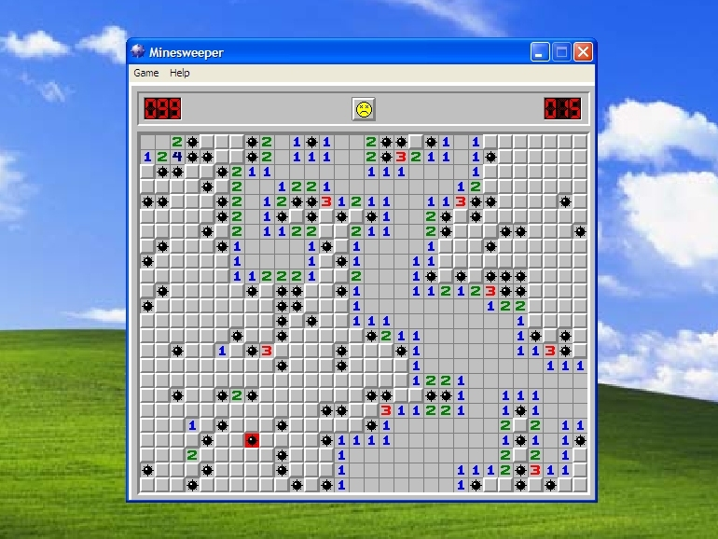
OVERVIEW: Designing a Text-Based Minesweeper Game
How to play:
Minefield of size n x m
Minefield contains cells of three types: mines, numbers, blanks
Choosing a blank cell results in a recursive call that reveals all surrounding blank cells
Numbers indicate how many mines it is touching
Mines are instant death
Use logic to clear board

Slide 3
The Design Process: Fields
Minefield
Cell
Mine
Number (1)
Class Minefield
Class Cell
Blank
Minefield contains cells ( - board : Cell[])
Status of minefield is incomplete until the player clears the board or they are dead (- gameDone : boolean)
Minefields contain a certain number of mines (- mines : int)
The player accumulates a score throughout gameplay (- score : int)
Cells can contain a mine, a number, or nothing (- type : Type, - number : int)
Cells are covered at the beginning of the game until they are uncovered by the player (- uncovered : boolean)
Cells have a position on the board that does not change (- xCoord : int, - yCoord : int)
Class MinefieldApp

Slide 4
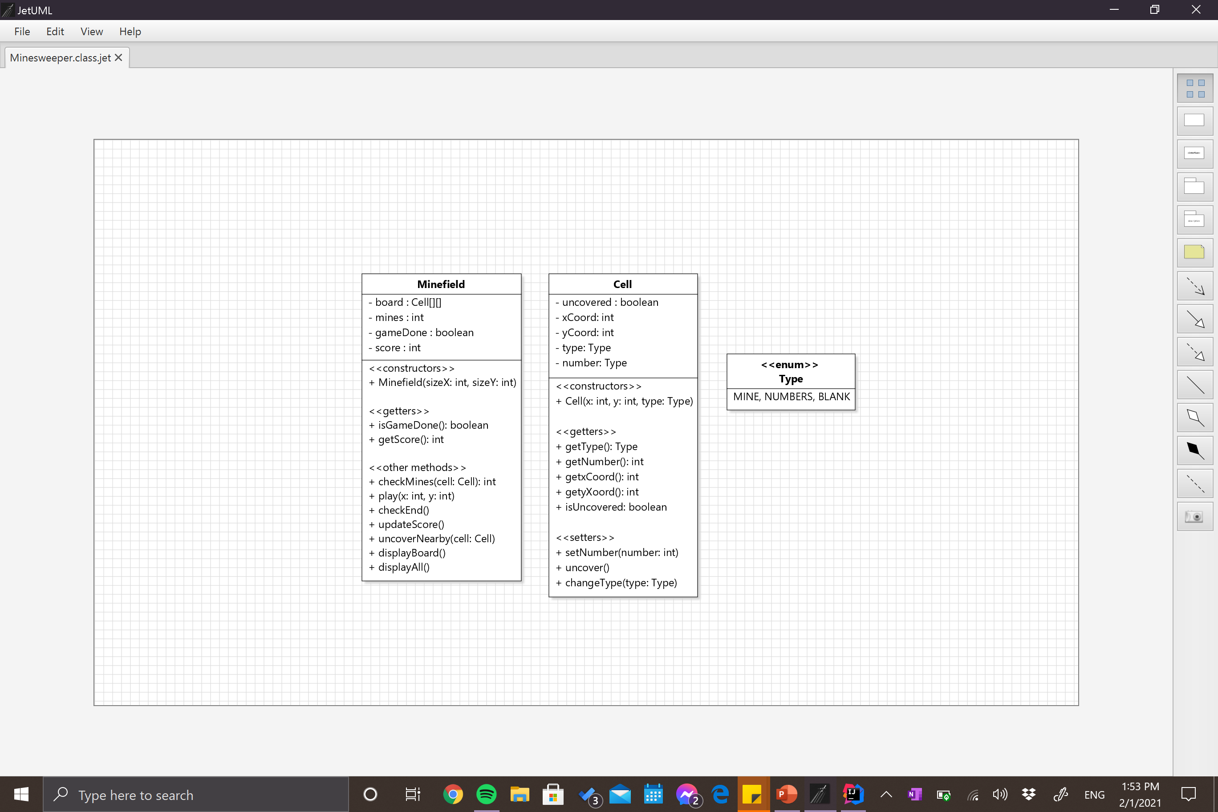
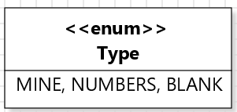
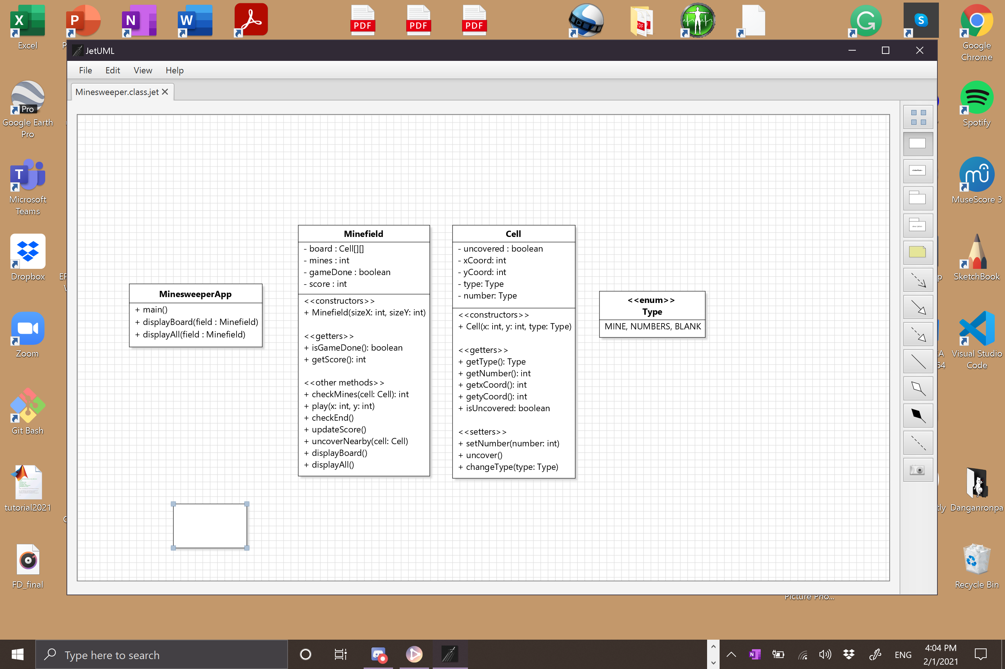
UML Class Diagrams (so far)

Slide 5
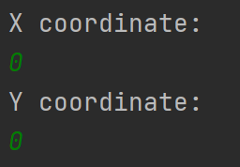
The Design Process: Methods
MinesweeperApp
Minefield
Cell
My approach: Analyze gameplay
Game input
Need to be able to interact with board (+ play(x : int, y : int))
How to identify a cell?
Cells can be identified by their position (+ getxCoord(), +getyCoord())
What happens when you choose a cell?
Depends on its type! (+ getType())
MINE – game over, display entire board (+ displayAll(field : Minefield)), (+ getBoard() : Cell[][])
NUMBER – reveal cell (+ getNumber())
BLANK – recursively reveal surrounding cells (- uncoverNearby(cell: Cell))
Set cell status to uncovered (+ uncover())
Receiving input from player

Slide 6
The Design Process: Methods
MinesweeperApp
Minefield
Cell
My approach: Analyze gameplay
What happens between each move?
Need to see updated board (+ displayBoard(field : Minefield)), (+getMines() : int)
Relay information to program about status (+isGameDone())
Update the player’s score (- updateScore())
If still alive, when do you know the board is fully cleared?
When all cells that are not MINE are uncovered (- checkEnd())

Slide 7
The Design Process: Methods
MinesweeperApp
Minefield
Cell
My approach: Creating the board
What does the board contain?
2D array of cells
Some cells have mines
The rest are blank or have numbers
How to add numbers? (- checkMines()) (+ setNumber(), +changeType())
Displaying the board? (previously mentioned)
Need to know status of cell (+ isUncovered())
Need to know number of cell (if it has one) (+ getNumber())
See current score (+getScore())

Slide 8
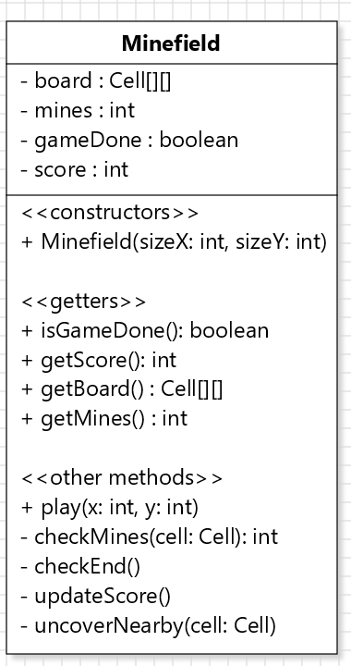
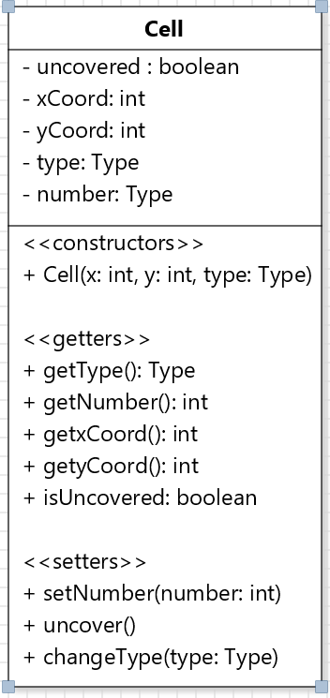
UML Class Diagrams (continued)

Slide 9
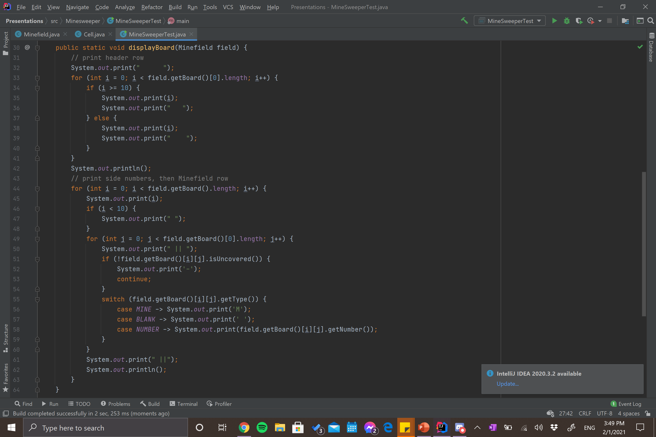
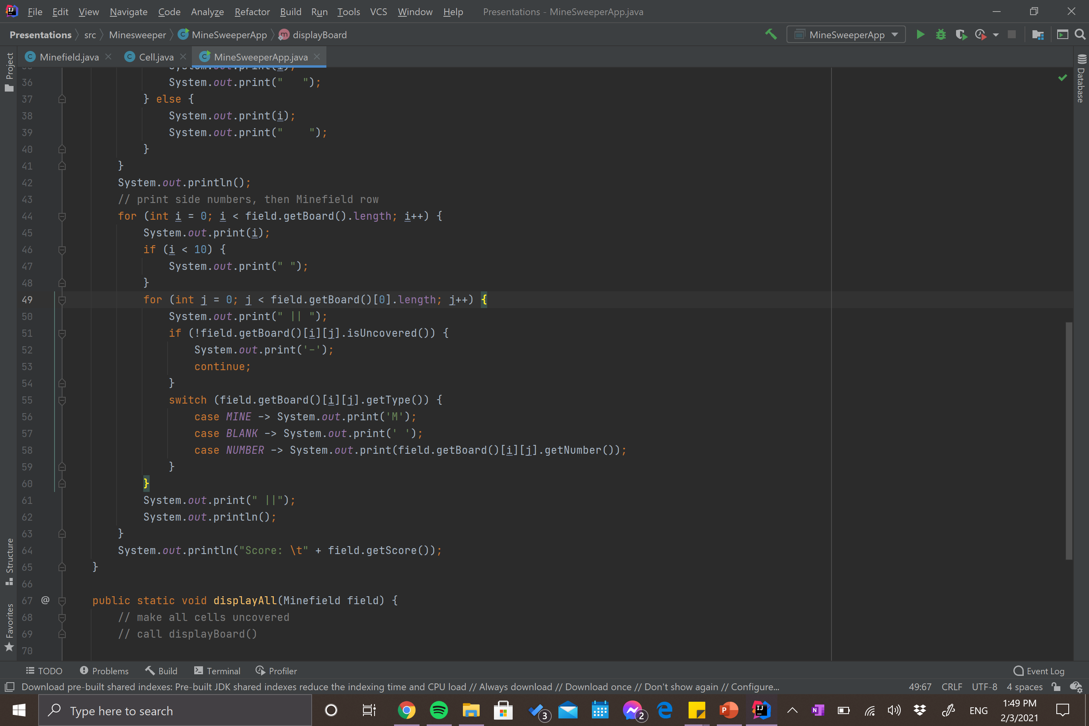
MinesweeperApp Method: displayBoard()

Slide 10
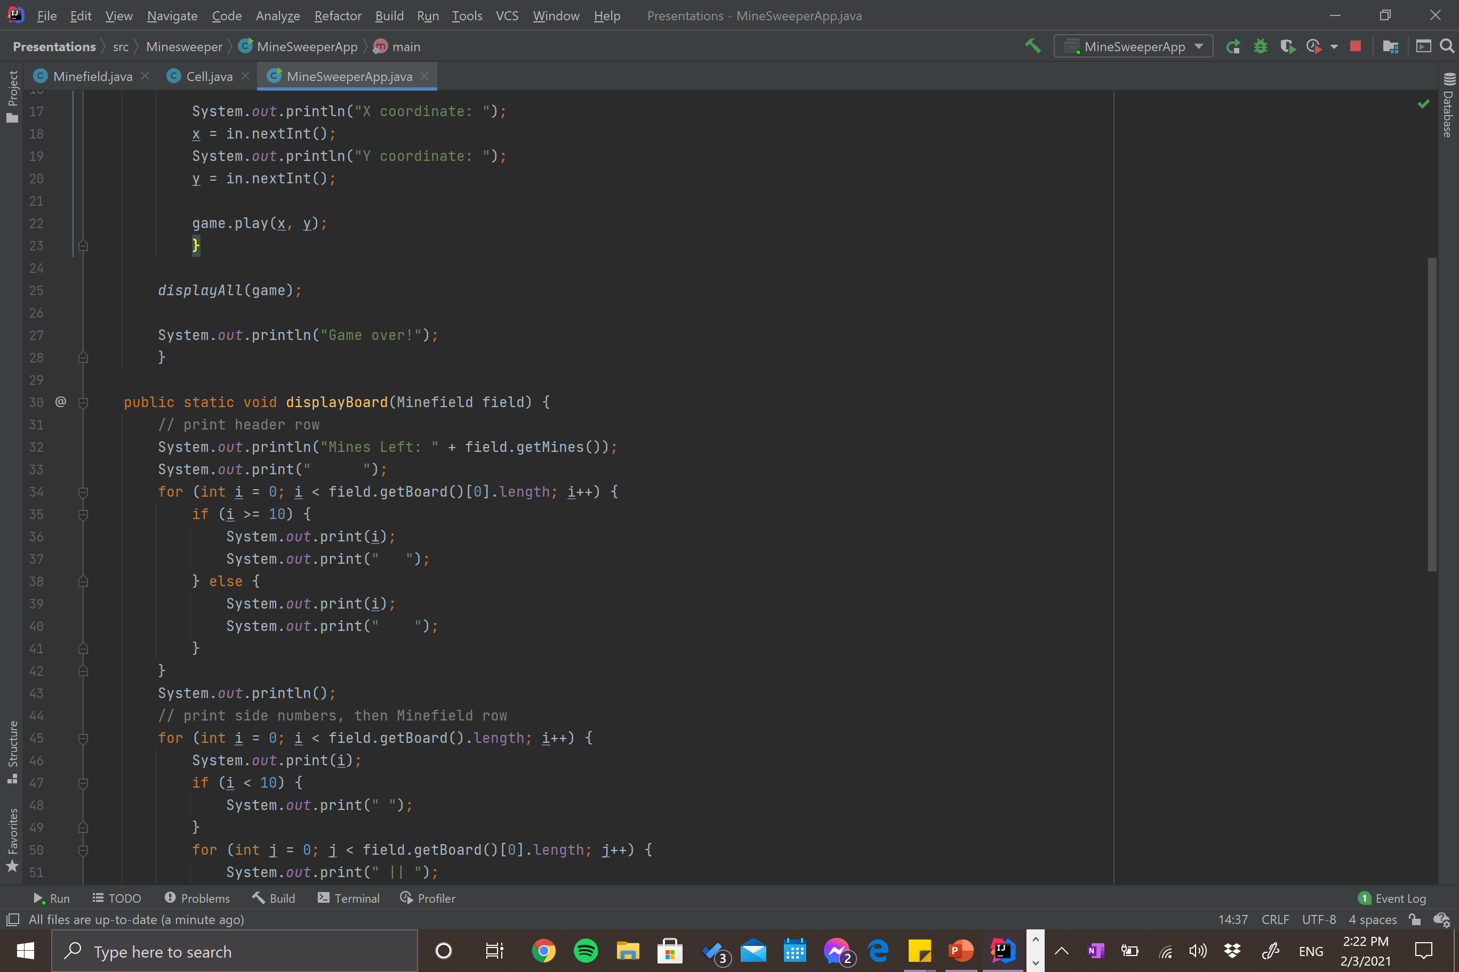
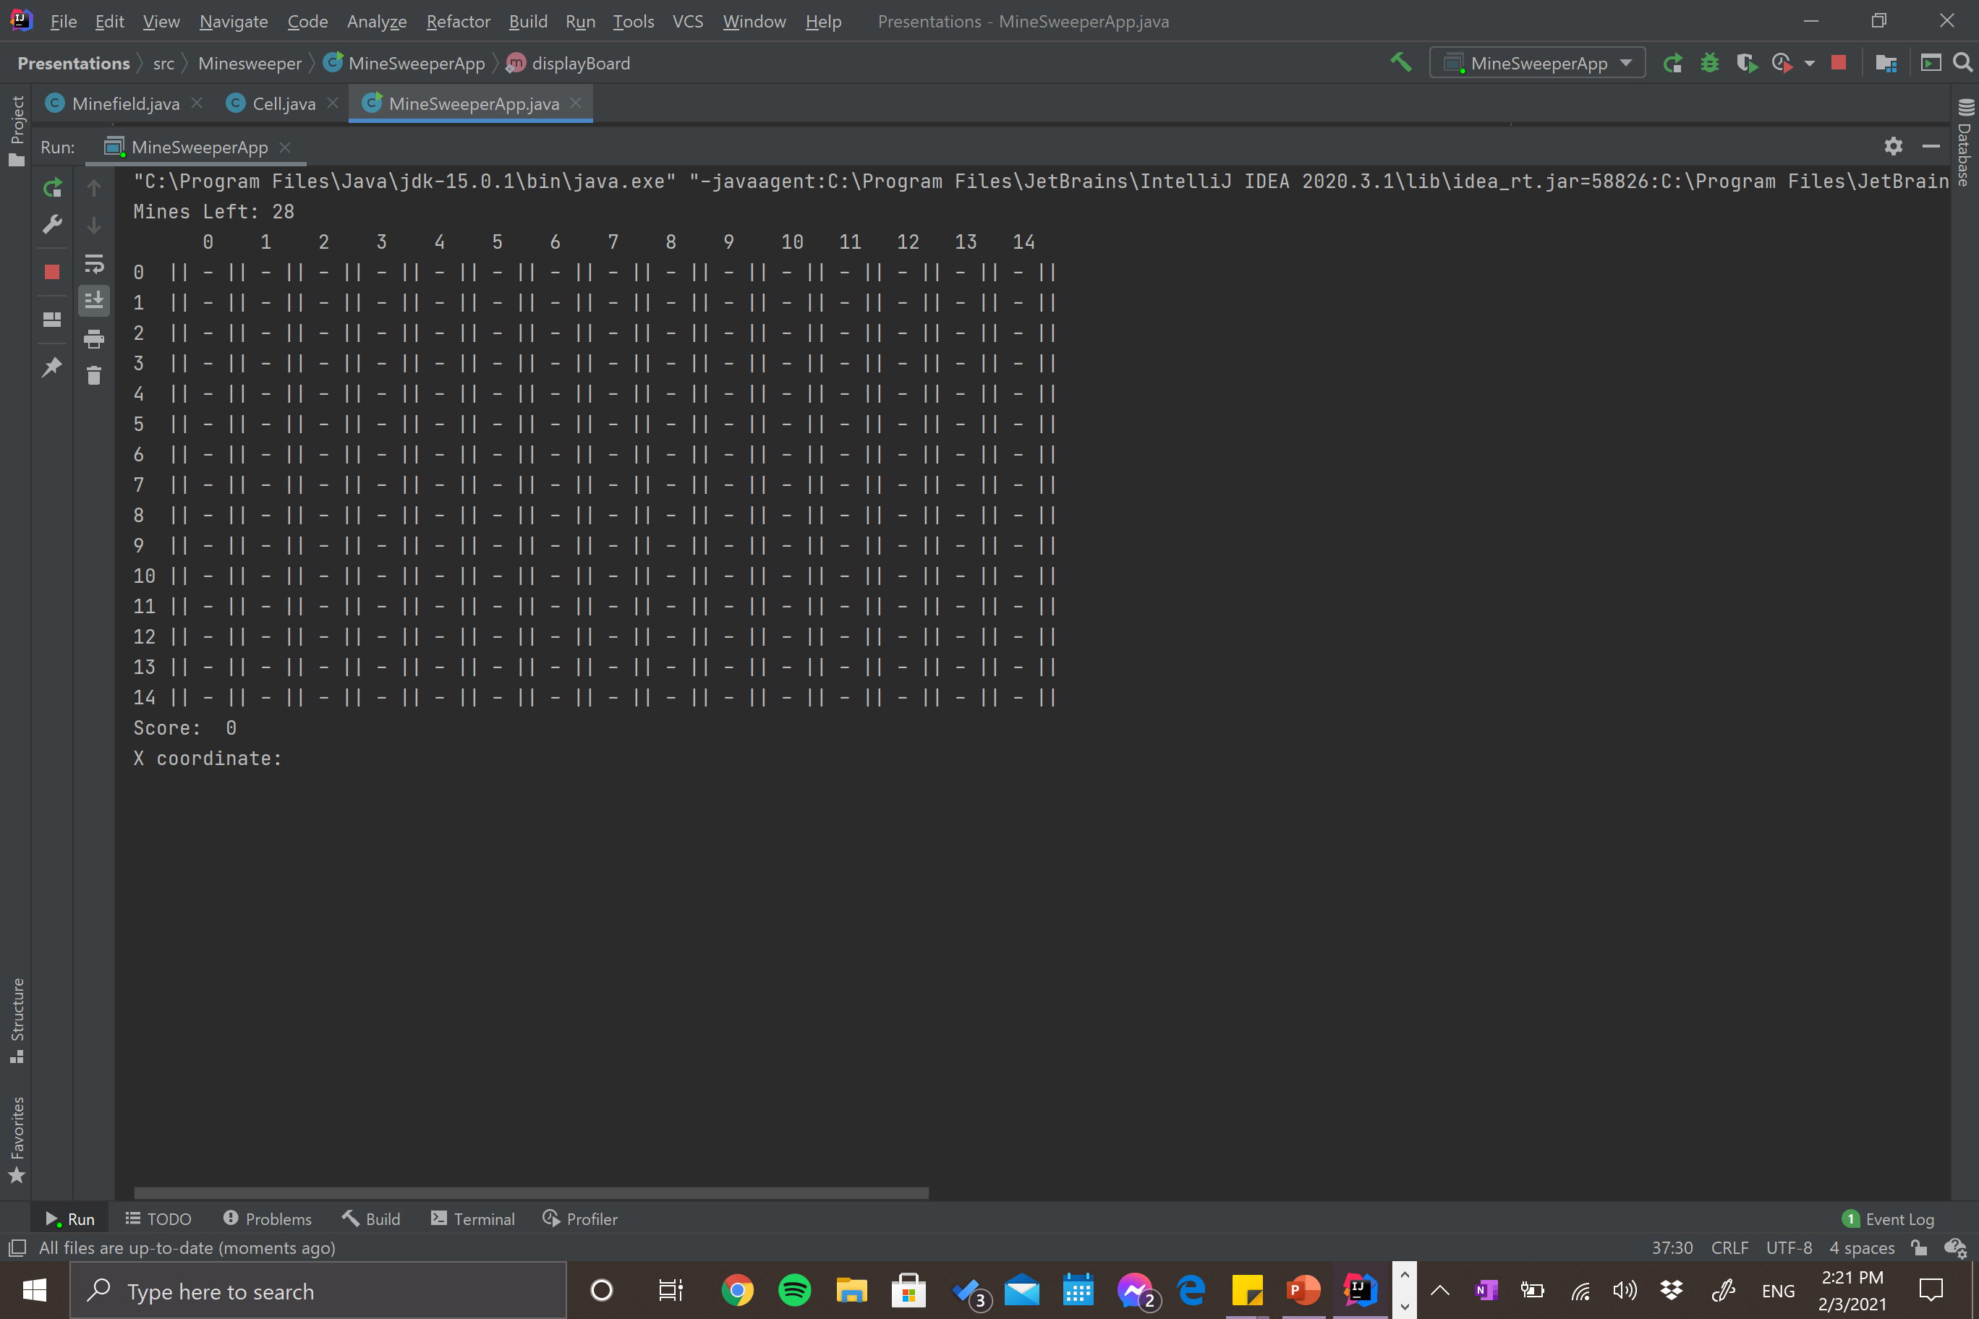

Slide 11
